Slide 1

Research on DC electric source characteristics
Artur Abdullin, Konstantin Gorshkov, Sergey Lovlin
Faculty of Control Systems and Industrial Robotics, ITMO University, Saint Petersburg

Slide 2

Contents
Objectives
Program of work
Basic theory
Guidance
Content of the report
Special tasks

Slide 3
Objectives
to learn how to use LTspice software for circuit analysis;
to study operating modes of electrical energy sources: open circuit, short-circuit and maximum power transfer;
to study the procedure of experimental determination of the electrical energy source equivalent circuit parameters;
to study the maximum power transfer theorem and Thevenin's theorem.

Slide 4
Program of work
simulate the circuit by LTspice;
plot the volt-ampere characteristic of real voltage source;
identify the parameters of the equivalent circuit for real electrical source based on experimental data.

Slide 5
LTspice
SPICE ("Simulation Program with Integrated Circuit Emphasis") - analog electronic circuit simulator.
First version of SPICE was developed at the Electronics Research Laboratory of the University of California, Berkeley in 1973.
LTspice – is freeware version of SPICE provided by Linear Technology.

Slide 6
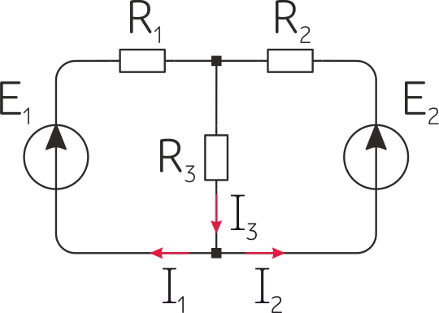
Task
Given that E₁=10 [V], E₂=20 [V], R₁=100 [Ω], R₂=200 [Ω]
and R₃=200 [Ω], find the currents.

Slide 7
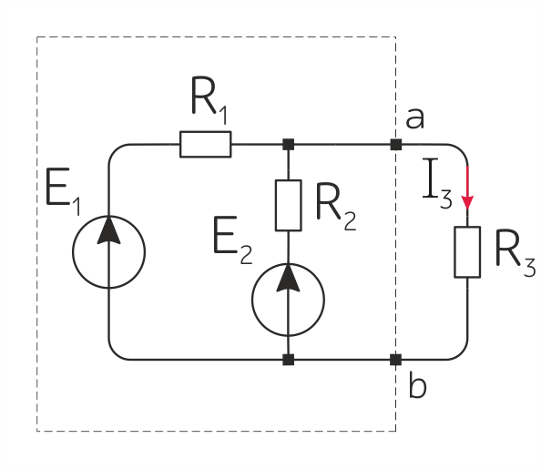
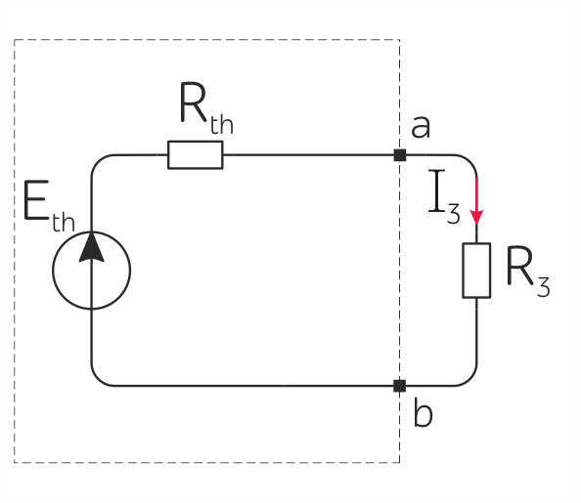

Thevenin's theorem (1883)
Any linear electrical network containing only one-ports can be replaced at terminals a-b by an equivalent combination of a voltage source E_{th} in a series connection with a resistance R_{th}.

Slide 8
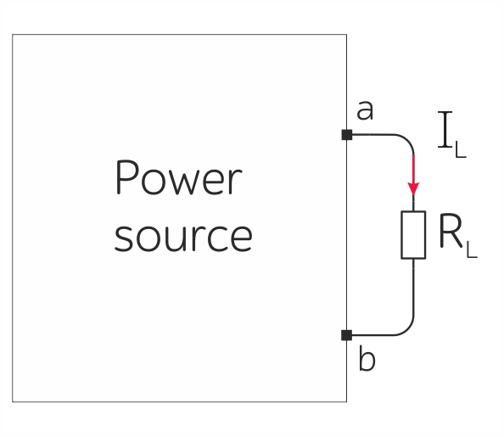
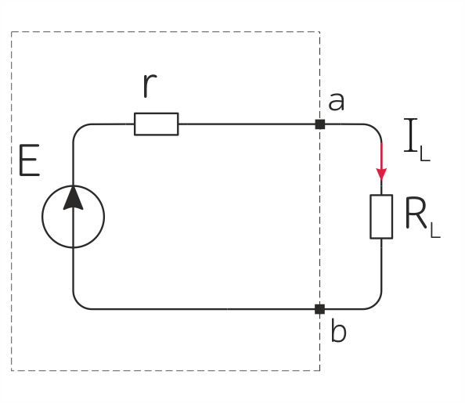
Thevenin's theorem (1883)
Any linear electrical network containing only one-ports can be replaced at terminals a-b by an equivalent combination of a voltage source E_{th} in a series connection with a resistance R_{th}.

Slide 9
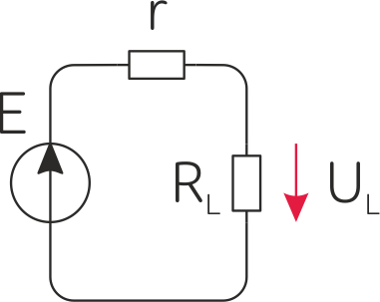
Maximum power transfer
The maximum power transfer theorem was developed by Moritz Hermann von Jacobi, a German and Russian engineer and physicist, around 1840.

Slide 10
Guidance
Open file EE_Lab1.pdf;
Open your circuit model of the real voltage source in LTspice;
Measure open circuit voltage U₀ and put the result in the Table 1.1.;
By changing load resistance determine its value which provides voltage in the load equal to U₀/2. Enter determined value in the table as r;
By varying load resistance from 0 [Ω] to 10000 [Ω] accordingly to the Table 1.1, obtain corresponding values of voltage, current and power dissipated in load, and put them into the Table 1.1.

Slide 11
Guidance
For each pair of current values and voltages for k = 2...10 calculate and put in the Table 1.1 source internal resistance r_{k} [Ω];
Find an estimate of the source's internal resistance r as a root mean square value;

Slide 12
Guidance
Calculate the short-circuit current of the source I_{sc} = U₀/r;
Calculate the efficiency η_{k} = R_{nk}/(r + R_{nk});
Draw a line on the plot through points [0, E = U₀] and [I_{sc}, 0] which will be the calculated volt-ampere characteristic of source and show points of the experimental characteristic according to the Table 1.1. on the same plot.
According to the Table 1.1, build power dependencies of load and efficiency.

Slide 13
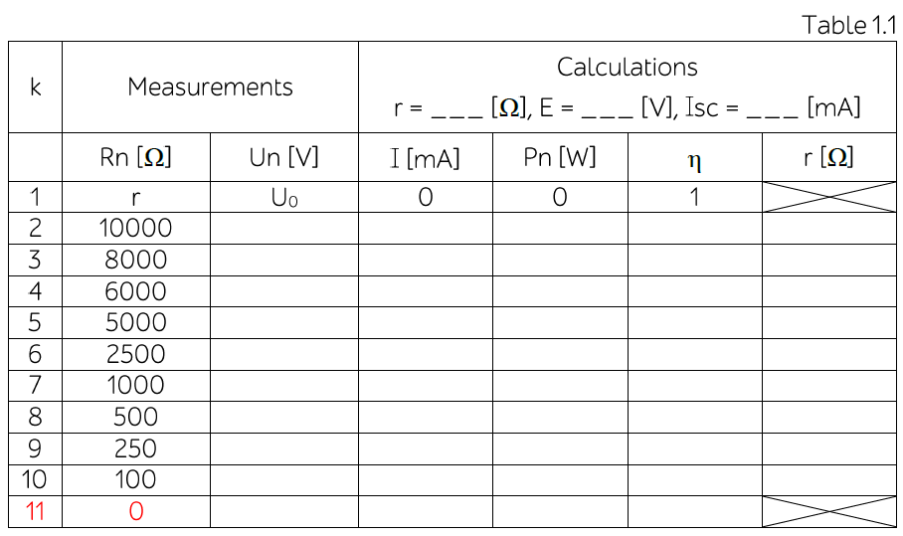
Table 1.1.

Slide 14
Content of the report
1. The equivalent circuit.
2. Filled Table 1.1.
3. Plot of the calculated and experimental characteristic of the source.
4. Dependency diagrams for Pn(In) and η(In).

Slide 15
Special tasks
Task 1. Use Thevenin's theorem to find E_{th} and R_{th}.
Task 2. Use equivalent transformations to find E_{eq} and R_{eq}.

